Slide 1

第二章 固体中的扩散
Diffusion in solids
答疑时间：陈浩 每周二下午3:00-5:00（请提前预约），wechat:18510548205
手机号：18510548205；Email:hao.chen@mail.Tsinghua.edu.cn

Slide 2
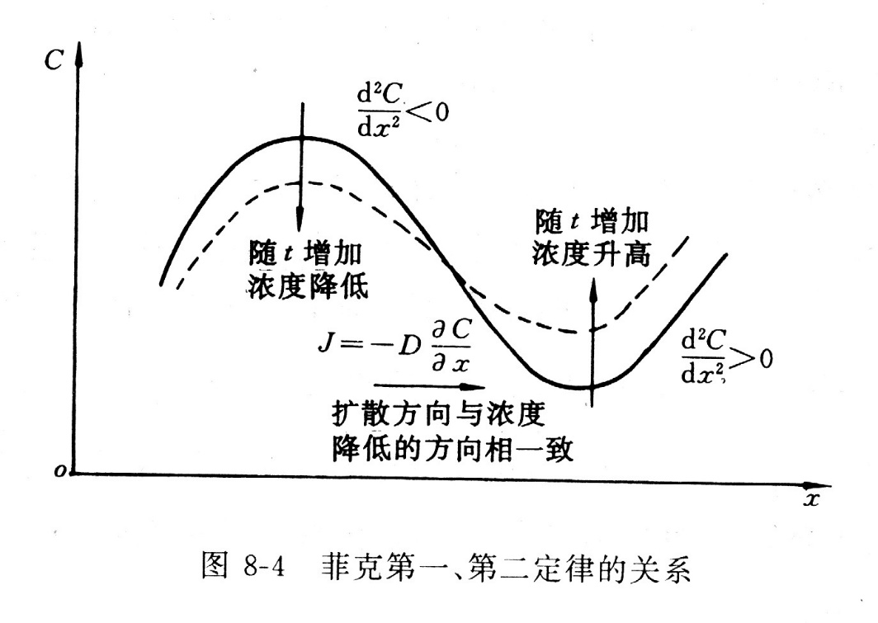
复习：
1. 扩散是什么？
扩散是指由于大量原子的热运动引起的物质的宏观迁移。
2. 扩散分类
互扩散/自扩散； 下坡扩散/上坡扩散; 短路扩散/体扩散；单相扩散/反应扩散
3. 扩散的应用
4. 扩散定律（宏观）
菲克第一定律:
菲克第二定律：

Slide 3
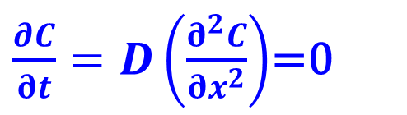
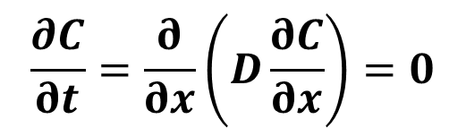

2.3 稳态扩散 （Steady state diffusion）
稳态扩散定义：在扩散系统中，任一点的浓度不随时间而变化，这种状态称为稳态扩散。
$$\frac{∂C}{∂t}=\frac{∂}{∂x}\left(D\frac{∂C}{∂x}\right)=0$$
D不是常数时
$\frac{∂C}{∂t}=D\left(\frac{∂^{2}C}{∂x^{2}}\right)$=0
D是常数时
简单地说，稳态扩散是指扩散通量J不随时间而变化的扩散。
$$J=−D\frac{∂C}{∂x}= 常数$$

Slide 4
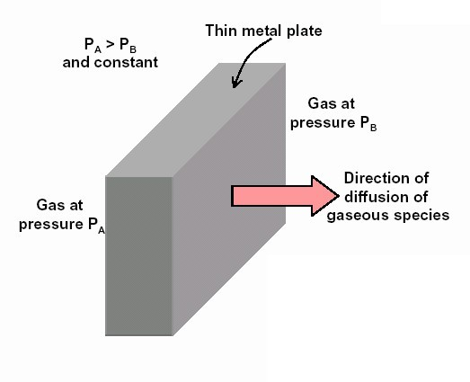
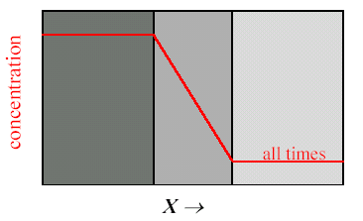
2.3.1 一维稳态扩散
考察氢通过金属薄板的扩散：
通过一个厚度为δ的薄板的稳态扩散（扩散系数D 为常数），板的两侧表面x=0和x= δ的浓度分别为C_{A}和C_{B}。扩散经过相当时间后，达到稳态。
C_{A}
δ
C_{B}

Slide 5
2.3.1 一维稳态扩散
用Fick第一定律来求解：
C
根据稳态扩散的条件，有：
C_{A}
边界条件：
C_{B}
0
δ
x
∴ 浓度C的表达式为：
∴ 扩散通量 J 为：
问题：
为了减少储存氢气的泄漏，应采取那些措施？
∴ 单位时间内通过面积A的氢气量为：

Slide 6
2.3.3 球对称稳态扩散

Slide 7
2.3.3 球对称稳态扩散

Slide 8
2.3 稳态扩散 （Steady state diffusion）
For slabs,
For spheres,
For cylinders,

Slide 9
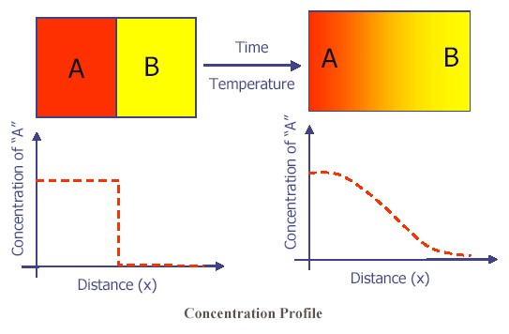
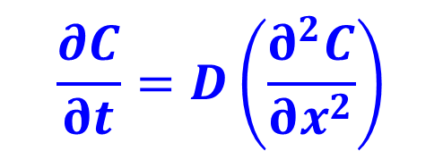
2.4 非稳态扩散
用Fick第二定律来求解：
$$\frac{∂C}{∂t}=D\left(\frac{∂^{2}C}{∂x^{2}}\right)$$
t=t₁
t=t₂
不同的初始和边界条件，解是不同的。
非稳态扩散定义：在扩散系统中，浓度随位置和时间而变化，这种状态称为非稳态扩散。

Slide 10

多选题
1分
菲克第一定律和第二定律：
A
都是描述固体材料中的扩散
B
第一定律仅适用于稳态扩散
C
第二定律仅适用于非稳态扩散
D
都是描述扩散使材料系统趋于平衡态
提交

Slide 11
投票
最多可选1项
封闭系统是否会发生问题扩散？
A
会
B
不会
提交

Slide 12
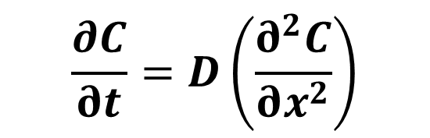
2.4.1 一维无穷长物体的非稳态扩散
$$\frac{∂C}{∂t}=D\left(\frac{∂^{2}C}{∂x^{2}}\right)$$
C=C₂
C₂>C₁
C=C₁
x
C₂
original state
解析解
数值求解
有限差分、有限元等
final state
C
after diffusion
C₁
0
x
初始条件
边界条件

Slide 13
2.4.1 一维无穷长物体的非稳态扩散
浓度随时间的变化关系式：
式中：
称为高斯误差函数（Gauss error function），或叫超越函数，可以查表得到。

Slide 14
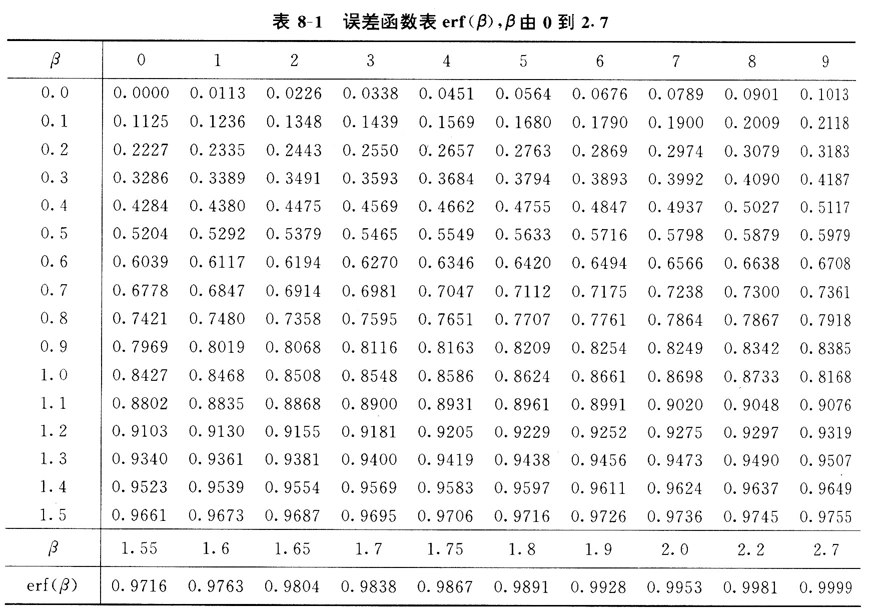
讨论：
思考题：多远可以近似为无穷远？
(1). 非稳态扩散方程的应用：

Slide 15
讨论：
(2). 任一时刻 C(x,t) 曲线的特点：
浓度梯度：
1）浓度曲线以中心(x=0, C=C_{o})是对称的
2）随着时间的增加，曲线的斜率变小，
当 t → ∞ 时，C → C_{o}

Slide 16
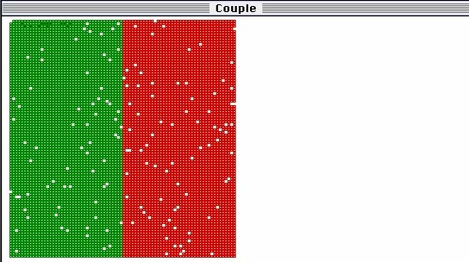
一维无穷长物体的非稳态扩散的计算模拟

Slide 17
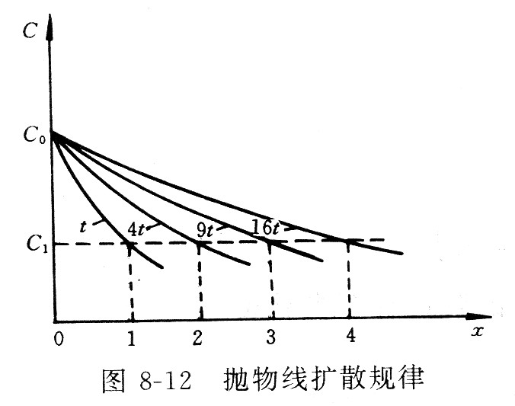
讨论：
(3). 抛物线扩散规律
C是β的单值函数，只要β（ ）不变，C就不变。
∴ 等浓度的面随着时间的变化而呈抛物线移动，说明扩散速度越来越慢。

Slide 18
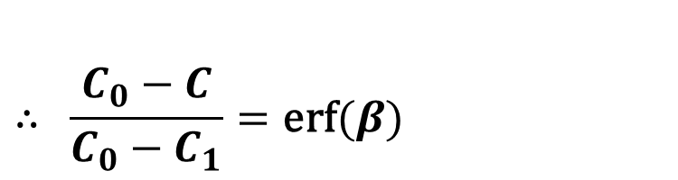
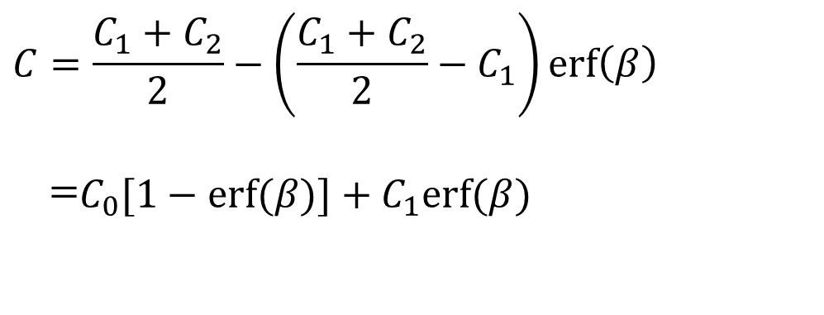
讨论：
(4). 扩散公式的变换（transformation）
$$C=\frac{C_{1}+C_{2}}{2}−\left(\frac{C_{1}+C_{2}}{2}−C_{1}\right)\text{erf}\left(β\right)$$
$$\begin{matrix}\end{matrix}\begin{matrix}=\end{matrix}C_{0}[1−\text{erf}(β)]+C_{1}\text{erf}(β)$$
$$∴\begin{matrix}\end{matrix}\frac{C_{0}−C}{C_{0}−C_{1}}=\text{erf}(β)$$

Slide 19
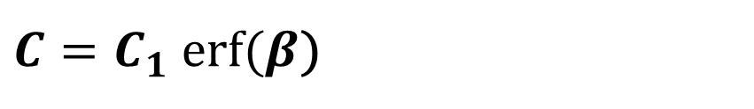
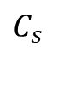
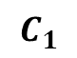
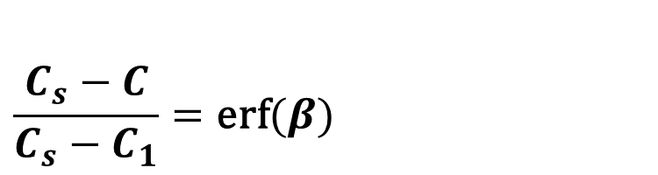
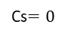

2.4.2 半无穷长系统（semi-infinite system）
$$\frac{C_{s}−C}{C_{s}−C_{1}}=\text{erf}(β)$$
$$C_{s}$$
金属表面渗碳、渗氮等处理（if C₁=0）
$$C=C_{s}\left(1−erf⁡(β)\right)$$
表面渗碳等
表面脱碳等
表面脱碳、真空除气（if C_{s}=0）
$C=C_{1}$ $erf⁡(β$)
$$C_{1}$$
Cs$=0$

Slide 20

讨论：
对于渗碳过程，浓度变化达到表面浓度的一半时，称为发生了显著扩散。
$$C=C_{s}\left(1−erf⁡(β)\right)$$
∴ 给出 x 可求出 t ，或给出 t 可求出 x 。

Slide 21
多选题
1分
一维非稳态扩散：
A
公式由菲克第二定律解得
B
无穷长系统扩散曲线在界面两侧呈中心对称
C
扩散距离与时间成抛物线规律
D
可用于渗碳计算
提交

Slide 22
单选题
1分
研究证明，在一定温度下钢中渗碳达到指定浓度所需的扩散时间和扩散距离具有一定的比例关系。要使扩散层的深度增加二倍，则扩散时间需增加
A
四倍
B
二倍
C
三倍
提交

Slide 23
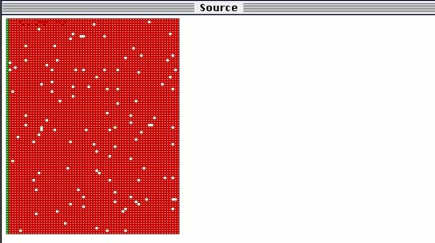

Slide 24
扩散方程的数值解法
补充内容，不做要求
以扩散系数为常数的一维扩散为例，介绍用有限差分法求数值解的过程。 差分方法就是用有限差分近似表示微分的方法。通常用网格（一维或多维的，视所讨论域的维数而定）覆盖所讨论的域，网格中离散的格点的集合代替了原来的连续域。
例如：我们讨论的一维扩散，浓度是距离x和时间t的函数C(x，t)。这个域是二维的，其中一维是x，另一维是t。设网格是等间距的，间距分别为Δx和Δt，第（i, j）个格点表示距离为iΔx、时间为jΔt，对应的浓度
C_{i, j}表示距离为iΔx经历时间为jΔt的浓度。
From余永宁

Slide 25
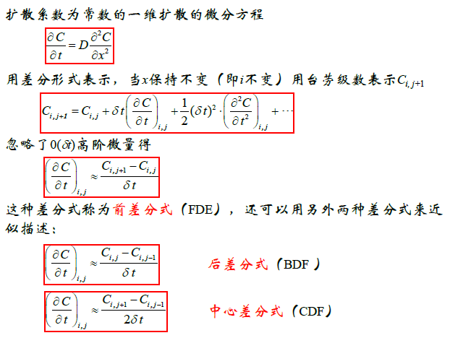
扩散方程的数值解法
From余永宁

Slide 26
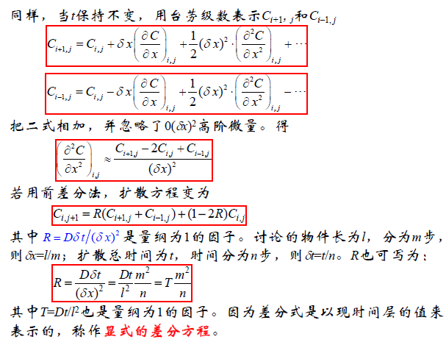
扩散方程的数值解法
From余永宁

Slide 27
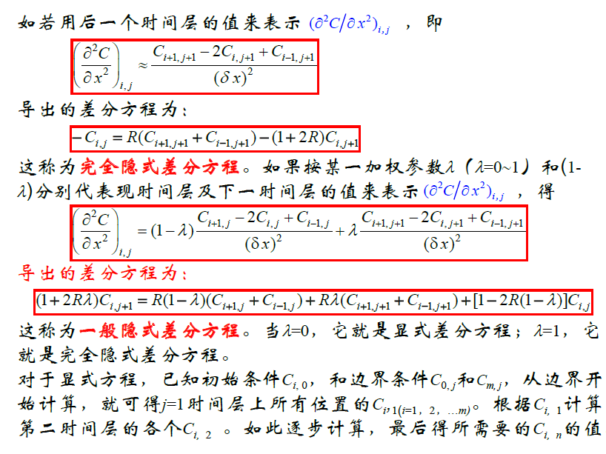
From余永宁
扩散方程的数值解法

Slide 28



相图和扩散计算
Thermo-Calc
DICTRA
TC-PRISMA
Stable and meta-stable heterogeneous phase equilibria
Amounts of phases and their compositions
Thermochemical data such as enthalpies, heat capacity and activities
Transformation temperatures, such as liquidus and solidus
Driving force for phase transformations
Phase diagrams (binary, ternary and multi-component)
Solidification applying the Scheil-Gulliver model
Thermodynamic properties of chemical reactions
And much, much more…
Microsegregation during solidification
Homogenization of alloys
Growth/dissolution of carbides, nitrides and intermetallic phases
Coarsening of precipitate phases
Interdiffusion in compounds, e.g. coating systems
Austenite to ferrite transformations in steel
Carburization, nitriding and carbonitriding of high-temperature alloys and steels
Post weld heat treatment
Sintering of cemented-carbides
And much, much more…
Concurrent nucleation, growth/dissolution and coarsening of precipitates
Temporal evolution of particle size distribution
Average particle radius and number density
Volume fraction and composition of precipitate
Nucleation rate and coarsening rate
Time-Temperature-Precipitation (TTP) diagrams
Continuous-Cooling-Transformation (CCT) diagrams
Estimation of multi-component interfacial energy

Slide 29
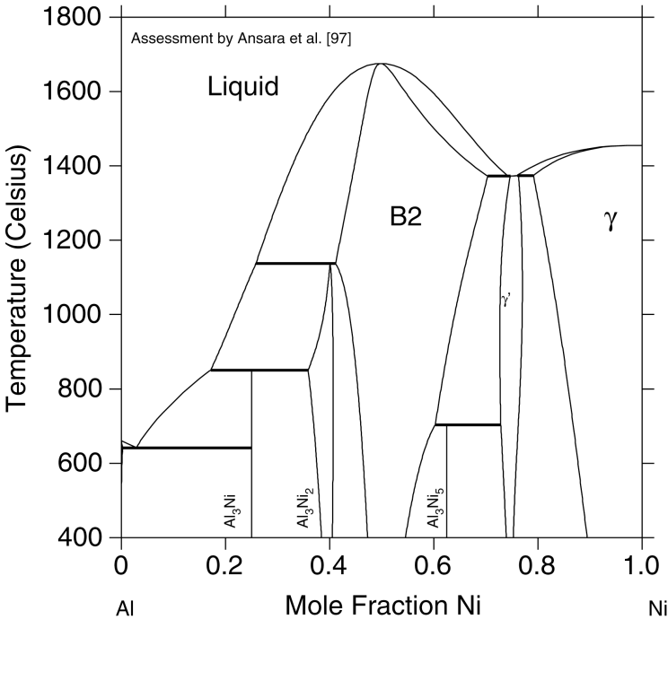
Working Principle-Thermocalc
Thermodynamic
Database
γ
B2
(Ni)
Thermo-Calc
Ni₃Al
Al Mole Fraction Ni Ni
Description of Gibbs free energy for the individual phases
Minimization of the total Gibbs free energy under given conditions.
Result

Slide 30
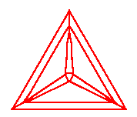
Working Principle-DICTRA
Solve Diffusion
where
Boundary conditions
(External or Internal)
Diffusivities
Gibbs Energy
Mobilities
Kinetic
DATABASES
Thermodynamic
A numerical finite difference scheme is used for solving a system of coupled parabolic partial differential equations.

Slide 31
Example 1
The surface of a 0.1% C steel gears is to be hardened by carburizing. In gas carburizing, the steel gears are placed in an atmosphere that provides 1.2% C at the surface of the steel at a high temperature. Carbon then diffuses from the surface into the steel. For optimum properties, the steel must contain 0.45% C at a depth of 0.2 cm below the surface. Design a carburizing heat treatment that will produce these optimum properties. Assume that the temperature is high enough (at least 900℃) so that the iron has the FCC structure.

Slide 32
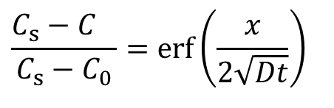
Solution:
We can use this equation:
$$\frac{C_{s}−C_{}}{C_{s}−C_{0}}=\text{erf}\left(\frac{x}{2\sqrt{Dt}}\right)$$
We know that C_{s} =1.2%C, C₀ =0.1%C, C=0.45%C, and x = 0.2 cm. From Fick’s second law:
From related table, we can find that:

Slide 33
Any combination of D and t whose product is 0.0198 cm² will work. For carbon diffusing in FCC iron, the diffusion coefficient is related to temperature by Equation:
From related table, we can find the values of Q and D₀:
Therefore, the temperature and time of the heat treatment are related by:

Slide 34
Some typical combinations of temperatures and times are:
If T = 900 ℃= 1173 K, then t = 116,174 s = 32.3 h
If T = 1000 ℃= 1273 K, then t = 36,360 s = 10.7 h
If T = 1100 ℃= 1373 K, then t = 14,880 s = 4.13 h
If T = 1200 ℃= 1473 K, then t = 6,560 s = 1.82 h
The exact combination of temperature and time will depend on the maximum temperature that the heat treating furnace can reach, the rate at which parts must be produced, and the economics of the tradeoffs between higher temperatures versus longer times. Another factor which is important is to consider changes in microstructure that occur in the rest of the material. For example, while carbon is diffusing into the surface, the rest of the microstructure can begin to experience grain growth or other changes.

Slide 35
Example 2
We find that 10 h are required to successfully carburize a batch of 500 steel gears at 900℃, where the iron has the FCC structure. We find that it costs $1000 per hour to operate the carburizing furnace at 900℃ and $1500 per hour to operate the furnace at 1000℃. Is it economical to increase the carburizing temperature to 1000℃? What other factors must be considered?
Solution:
We can use the solution to Ficks’s second law given by Equation:

Slide 36
Notice that we are dealing with only changes in heat treatment time and temperature, the term Dt must be constant.
To achieve the same carburizing treatment at 1000℃ as at 900℃:
The temperatures of interest are 900℃ = 1173 K and 1000℃ = 1273 K. For carbon diffusing in FCC iron, the activation energy is 32,900 cal/mol.

Slide 38
Notice, we really did not need the value of the pre-exponential term D₀, since it canceled out.
At 900℃, the cost per part is ($1000/ h)(10 h)/500 parts = $20/part
At 1000℃, the cost per part is ($1500/ h)(3.299 h)/500 parts = $9.90/part
Considering only the cost of operating the furnace, increasing the temperature reduces the heat-treating cost of the gears and increases the production rate. Another factor to consider is if the heat treatment at 1000℃ could cause some other microstructural or other changes? e.g. grain growth, residual stress caused during cooling from a higher temperature, life of the other equipment such as the furnace and accessories, and so on.

Slide 39
The point is, as engineers, we need to ensure that the solution we propose is not only technically sound and economically sensible, it should recognize and make sense for the system as a whole.
A good solution is often simple, solves problem for the system, and does not create new problems.

Slide 40
Example 3
Devices such as transistors are made by doping semiconduc-tors with different dopants to generate regions that have p- or n-type semiconductivity. The diffusion coefficient of phospho-rus (P) in Si is D = 6.5×10^{－13} cm²/s at a temperature of 1100 ℃. Assume the source provides a surface concentration of 10²⁰ atoms/cm³ and the diffusion time is one hour. Assume that the silicon wafer contains no P to begin with.
Calculate the depth at which the concentration of P will be 10¹⁸ atoms/cm³. State any assumptions you have made while solving this problem.
What will happen to the concentration profile as we cool the Si wafer containing P?
What will happen if now the wafer has to be heated again for boron (B) diffusion for creating a p-type region?

Slide 41
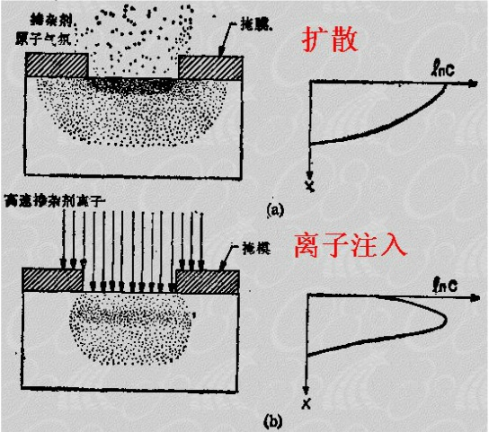
Ways of doping

Slide 42
Solution:
(a) We can use one of the solutions to Fick’s second law:

Slide 43
From the error function values in Table,
If erf(z) = 0.99, z = 1.82, therefore,
so

Slide 44
The main assumptions we made are (i) the D value does not change while phosphorus (P) gets incorporated in the silicon wafer and (ii) the diffusion of P is only in one dimension (i.e., we ignore any lateral diffusion).
(b) When the wafer is cooled down to room temperature, the profile will essentially stay the same. Thus, at room tempe-rature we will have essentially the same distribution of P as we had at 1100℃. The temperature has a strong effect on the diffusion process and, as we cool the wafer down, the diffusion rate drops substantially and hence the profile remains constant.

Slide 45
(c) Temperature and time have not been specified for diffusion of boron (B). These will have to be accounted for. Typical temperatures for boron (B) diffusion are between 900~1200 ℃ and we can expect that at these temperatures P diffusion will also be significant. When we heat the wafer again for boron diffusion, we will have to make sure P does not begin to substantially diffuse into parts of the wafer (dopant redistribution). We also have to ensure that boron does not get diffused into regions containing P and if it does we have to account for the effects on processing and electrical properties of the resultant device.

